Slide 1

Generative ART
with
JavaScript

Slide 2
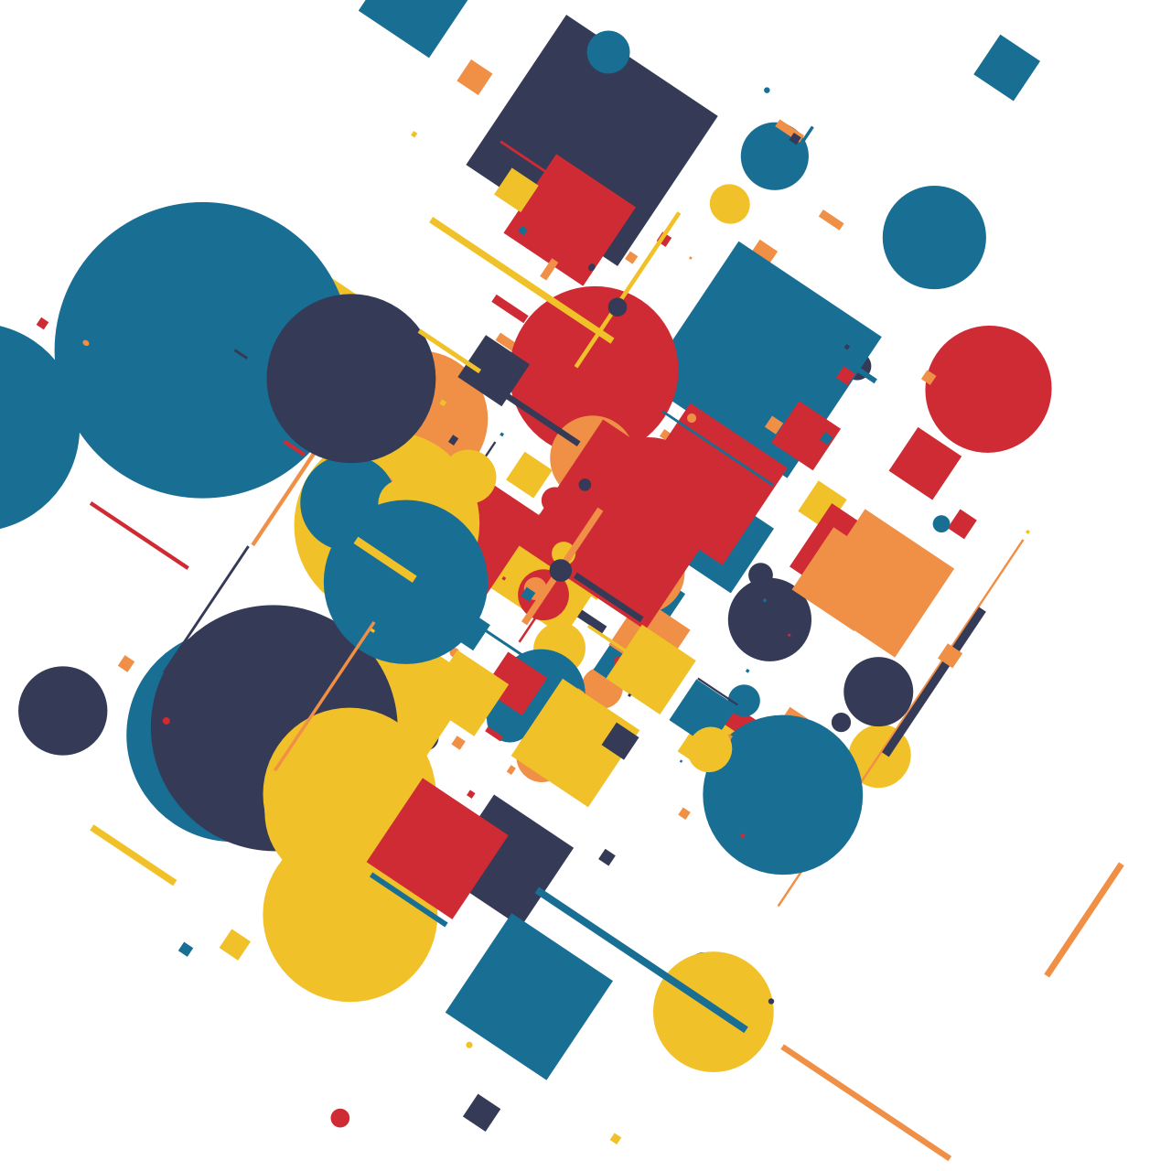
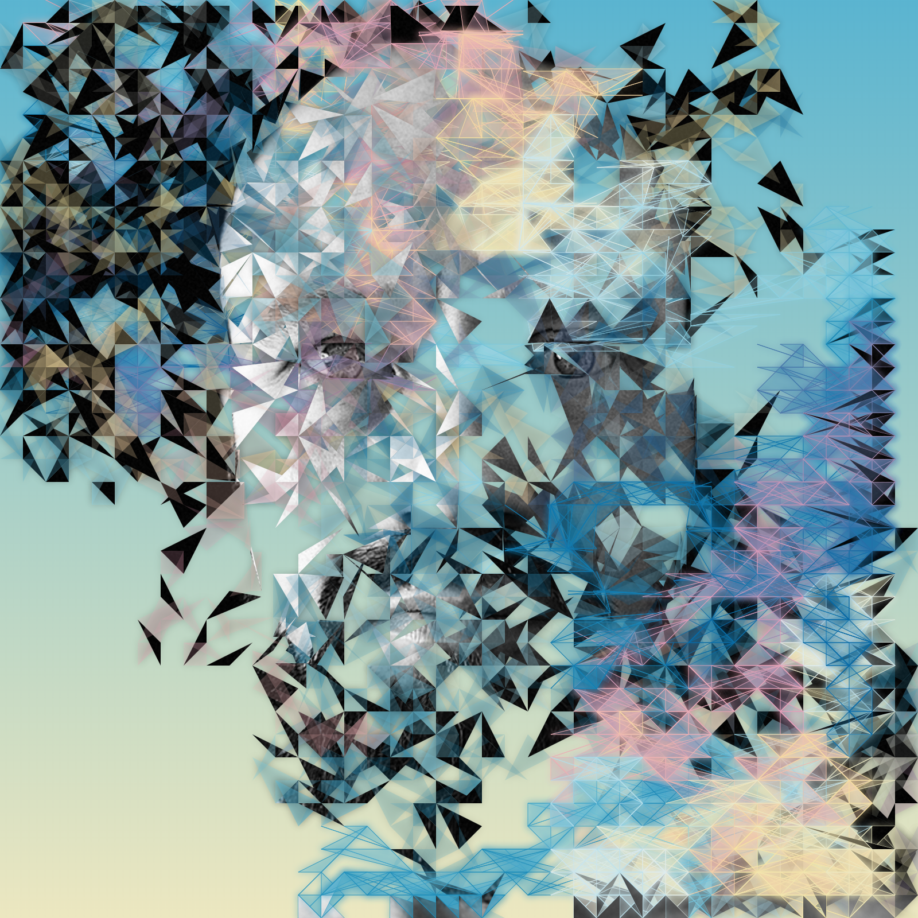
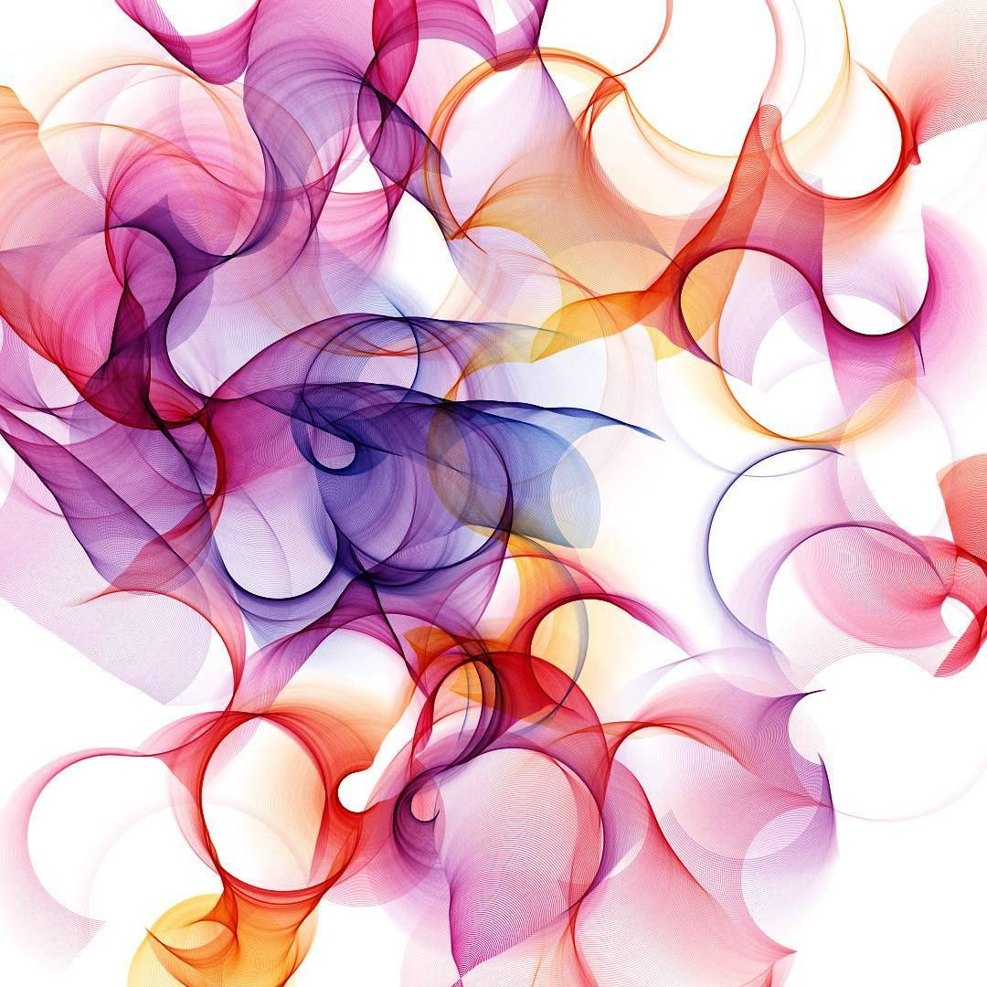
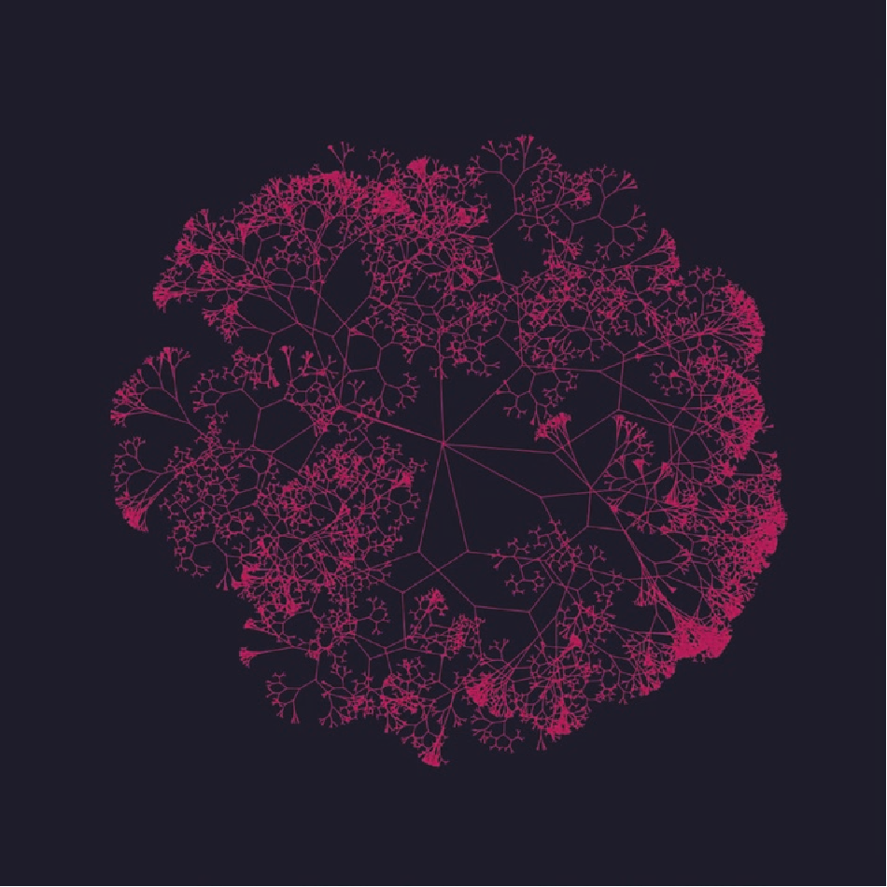
Some Examples of Generative ART

Slide 3
What is p5.js ?
JavaScript
JavaScript Library
Library for creative coding
Visualisation of math equations
Tool for GENERATIVE ART
VUE
D3
p5.js

Slide 4
Why p5.js ?
Works in the browser without the need of installation.
Easy to begin.
Equivalent to creating visual art full of beauty.
Immediate output makes it more convenient.

Slide 5
p5.js user interface
p5.js
Fourier Series animation to create a SQUARE wave..

Slide 6
p5.js Examples
Creating Patterns
Square pattern 1
Square pattern 2
Animation
Planets
Trees
Models
Structure
Heart
Model
Greeting Cards
Diwali Greeting
Christmas Greeting
Notes:
Sq pattern : Math.random wrapped as Random() in p5.js
Using widgets for eg : slider to control the size of the square.
STRUCTURE : use of WEBGL( web graphics library ) as well as ‘2d’ context for eg CANVAS tag in HTML
HEART : CAD images are difficult to visulaise… convert the CAD file to .obj extension and create a 3D effect
Christmas Greeting : add sound to the frontend overlay transparent CANVAS for various elements

Slide 7
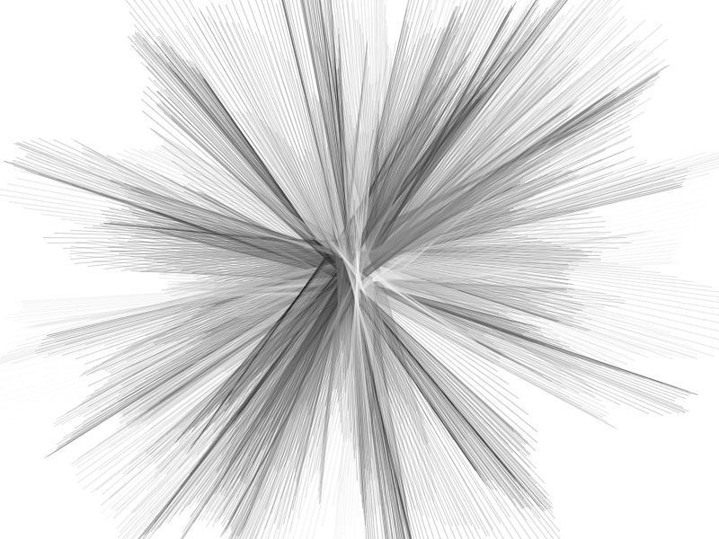
Thank you

